Slide 1

Tredyffrin Easttown School District
Reading Support Parent Information Meeting
Elementary School Title 1
Dr. Patrick Gately, Language Arts Supervisor
Dr. Oscar Torres, Title 1 Coordinator

Slide 2
What is Title 1?
Title I provides federal funding to schools to help students who demonstrate academic needs and are at most risk of falling behind.
Title I school designation is based on the percentage of students receiving free/reduced lunch.
Title 1 designation may change from year to year, however services across our elementary schools do not.

Slide 3
Components of Title 1
School/Parent Compact Agreement
  School, Parent, and Student Participation
Parent and Family Engagement
  Website, parent meetings, open house, and conferences.
Planning, Review and Improvement
District Budget and Funding
Dr. Gately and Dr. Torres will be available to answer additional questions.

Slide 4
Home and School Component
Fall Parent Meetings
Reading Calendars
Reading Logs
Newsletters
Home Literacy Activities
Parent Workshops

Slide 5
TESD Elementary Reading Specialists
Beaumont Elementary | Devon Elementary | Hillside Elementary | New Eagle Elementary | Valley Forge Elementary | All Elementary Buildings
Hayley Rodgers rodgersh@tesd.net 610-240-1406 | Gen Billet billete@tesd.net 610-240-1450 | Mary Nagle naglem@tesd.net 610-240-1511 | Lindsey Klotz-Sofranko klotzl@tesd.net 610-240-1557 | Laura Hobbins hobbinsl@tesd.net 610-240-1611 | Kirsten Firestine firestinek@tesd.net 610-240-1600
Your child's Reading Specialist takes great pride and care to ensure their academic success. Please do not hesitate to reach out to them if you have questions or concerns, if you need advice, or would like assistance with your child’s reading development.

Slide 6
Qualifying for Reading Support

Slide 7
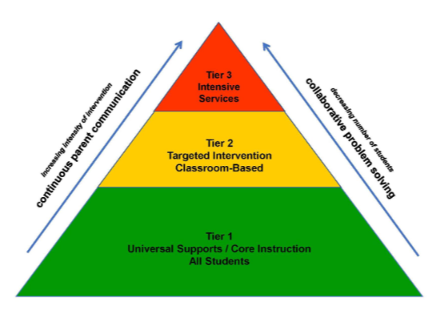
Multi-tiered System of Support (MTSS):
Data-driven decision making

Slide 8
Screening Process Kindergarten
Pre-Kindergarten Questionnaire
Kindergarten Teacher Recommendations
Kindergarten Screener (Fall)
Benchmark Assessments
Reading Specialist Recommendations
Parent / Teacher Conferencing
Wonders Assessments

Slide 9
Entrance/Exit Criteria: Kindergarten
Entrance Criteria | Exit Criteria
Kindergarten Screener | Kindergarten Mid-Year, KIDS
Student performance on Acadience Benchmark Assessments: First Sound Fluency Letter Naming Fluency Composite Score | Student performance on Acadience Benchmark Assessments: First Sound Fluency Letter Naming Fluency Phoneme Segmentation Fluency Nonsense Word Fluency
Wonders Assessments | Wonders Assessments
*Students receiving support are progress monitored on reading goals frequently. Information is shared with parents through conferences and the parent Power School portal.

Slide 10
Screening Process Grade 1
Kindergarten Inventory of Developmental Skills (KIDS) (Spring)
Kindergarten Teacher Recommendations (Spring)
First Grade Teacher Recommendations (Fall)
Benchmark Assessments
Reading Specialist Recommendations
Parent / Teacher Conferencing
Wonders Assessments

Slide 11
Entrance/Exit Criteria: Grade 1
Entrance Criteria | Exit Criteria
Student performance on Acadience Benchmark Assessments: Letter Naming Fluency Phoneme Segmentation Fluency Nonsense Word Fluency Composite Score | Student performance on Acadience Benchmark Assessments: Letter Naming Fluency Phoneme Segmentation Fluency Nonsense Word Fluency Oral Reading Fluency
Wonders Assessments | Wonders Assessments
*Students receiving support are monitored more frequently. Information is shared with parents through conferences and the parent Power School portal.

Slide 12
Screening Process Grades 2-4
Standardized Tests: ERB Reading Comprehension & PSSA
Benchmark Assessments
iReady – Grades 3 and 4
Reading Specialist Recommendations
Parent / Teacher Conferencing
Wonders Assessments

Slide 13
Entrance/Exit Criteria: Grades 2 - 4
Entrance Criteria | Exit Criteria
Student performance on Acadience Benchmark Assessments: Nonsense Word Fluency Oral Reading Fluency Maze Composite Scores Standardized Assessments: ERB, PSSA | Student performance on Acadience Benchmark Assessments: Oral Reading Fluency Maze
Wonders Assessments, iReady- 3rd,4th | Wonders Assessments, iReady- 3rd, 4th
**Students receiving support are progress monitored on reading goals frequently. Information is shared with parents through conferences and the parent Power School portal.

Slide 14
Parent Involvement

Slide 15
Reading Support Team
Parents
Students
Reading Specialists
Teachers
Principal
Language Arts Supervisor

Slide 16
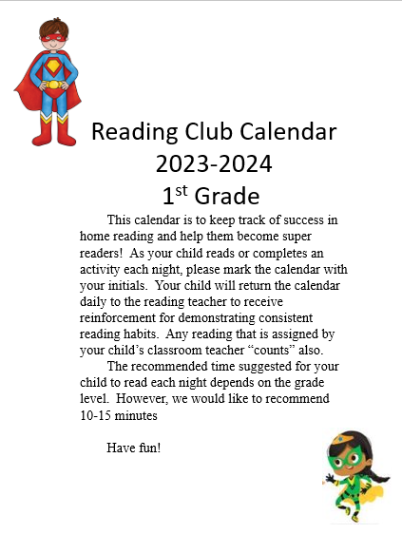
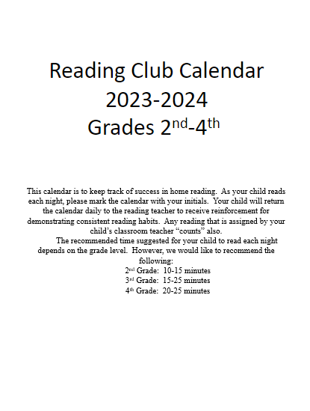

Home Reading Practice
Home Reading

Slide 17
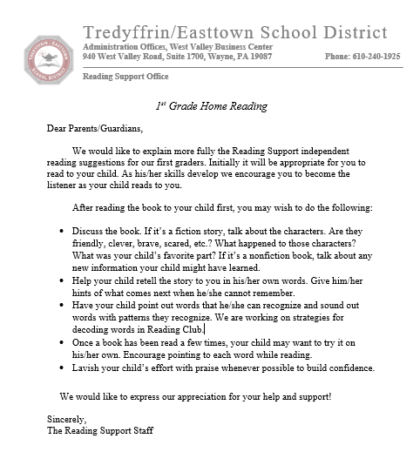

Home Reading Practice
First Grade
Home Reading

Slide 18
The Power of Praise and Encouragement
“I know this is hard for you. Thank you for doing your best.”​
“I like the effort you put into reading with me.”​
“I appreciate the way you listened to the story.”
“That was great expression! You​ sounded like a real performer.”
“I like the way you stopped at the​ periods.”​
“You did a good job stretching ​out the sounds in that word.”

Slide 19
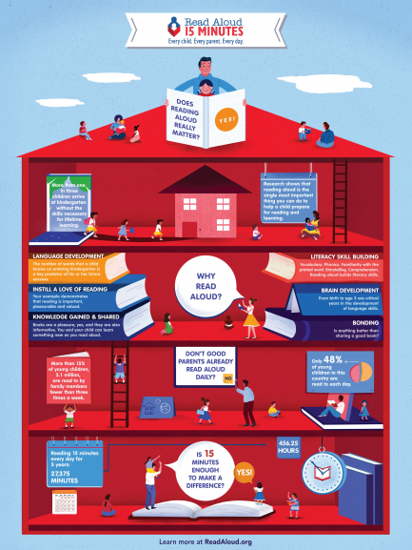
Reading aloud…
Is fun​
Opens doors​
Builds the desire to read​
Develops background knowledge & vocabulary​
Gives educational advantage​
Establishes bonds of love​
Develops the ability to read alone​
Models fluent expressive reading
http://readaloud.org/

Slide 20
Elementary School Break Out
Beaumont Room 116
Devon Room 102
Hillside Room 103
Valley Forge Room 104
New Eagle Room 105

Slide 21
Strategically designed, data driven instruction tailored for individual students.
Tredyffrin Easttown School District Reading Support Program

Slide 22
Reading Support Structure
1-6 students participate in Reading Support, 3-6 times a cycle,
for a minimum of 30-minute instructional sessions.
    Complements & supports reading instruction in the classroom.
    Offers additional opportunities for multi-sensory, systematic, explicit reading instruction in the five key areas.
    Instruction, duration and intensity is strategically designed and tailored to address each students’ relative areas of weaknesses and strengths.
Students in Reading Support are included and participate in the regular classroom for reading & language arts; students do not miss new classroom instruction while participating in reading support.

Slide 23
Curriculum and Instruction
The reading support curriculum is based on Orton-Gillingham methodologies and instruction.
Some examples of programs and materials used may include:
Equipped for Reading Success
Heggerty Phonemic Awareness
S.P.I.R.E.
UFLI
IMSE
The Reading Comprehension Blueprint
Wonders
Instructional decisions are based on the identified needs of the individual student through multiple measures and extensive data collection.

Slide 24
Some Examples of the Reading Support Block
Day | Block 1 | Block 2 | Block 3 | Block 4
Day 1 - 6 | Phonemic Awareness (5 min) | Phonics and Word Study, Fluency (5 min) | Spelling / Writing (10 min) | Vocabulary, Comprehension, Fluency and Writing (10 min)
As students are approaching grade level proficiency,
they may begin to receive less and/or different support.
Day | Block 1 | Block 2 | Block 3 | Block 4
Day 1, 3, 6 | Phonics and Word Study, Fluency (3-5 min) | Spelling / Writing (5 min) | Vocabulary, Comprehension, Fluency (10 min) | Text Analysis and Essay Writing (10-12 min)

Slide 25
The goal of this presentation is to help you help your child at home by:
Providing an understanding about how children learn to read.
Providing ideas and activities that you can do at home with your child.
Providing an understanding of literacy at home.
Providing resources to read and organizations to contact for more information.

Slide 26
Keys to Learning How to Read
According to research, becoming a reader involves the development of important skills, including…
Listening and responding to stories read aloud.
Recognizing and naming letters of the alphabet.
Listening to the sounds of spoken language.
Connecting sounds to letters to unlock the “code of reading”.
Reading often so that recognizing words becomes easy & automatic.
Learning and using new words.
Understanding what is read. https://www.readingrockets.org/

Slide 27
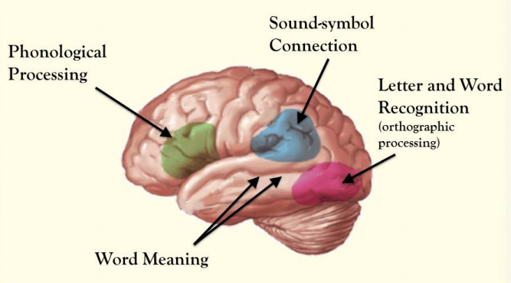
The Reading Brain
Phonological Processing
  Sounds and language
Orthographic Processing
  Letter and word recognition
Sound & Symbol Connection
  Phonics
Word Meaning
  Meaning and Context = Comprehension

Slide 28
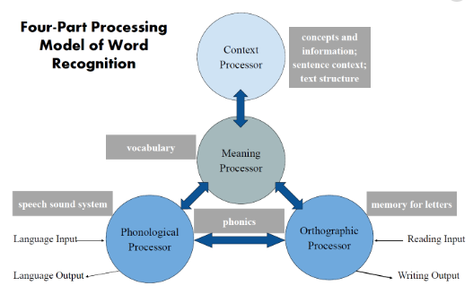
How Children Learn to Read
Seidenberg and McClelland, 1989

Slide 29

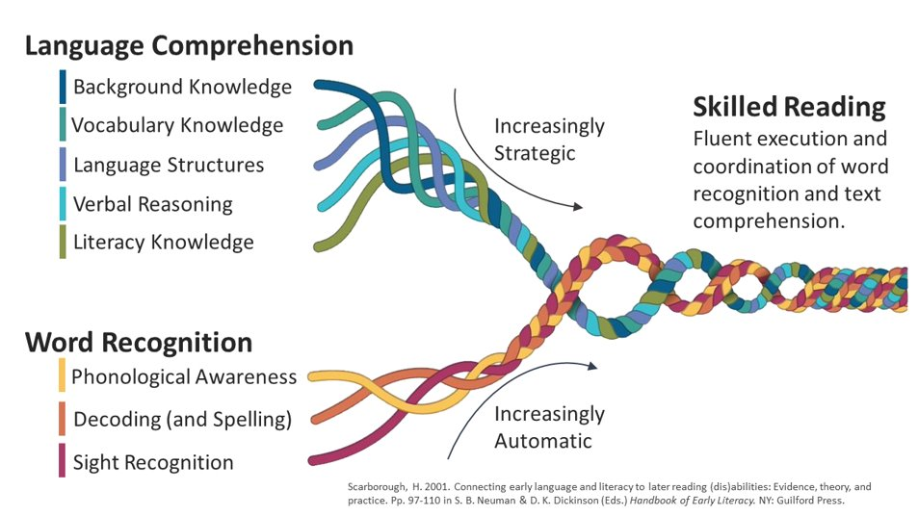

Slide 30

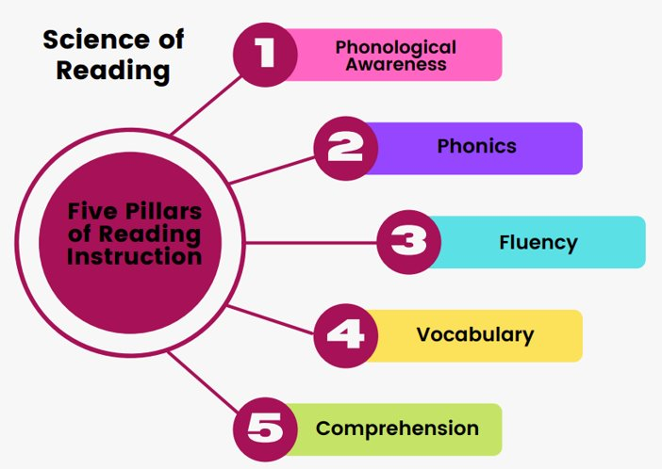
The Building Blocks of Reading

Slide 31
Research tells us that children need these five components to become skilled readers.
1. Phonological Awareness
Focusing on sounds
Every spoken word is a series of sounds.
Before a child is able to read, they need to become aware of how sounds work.
Build spoken language by talking and listening.
https://www.readingrockets.org/reading-101/reading-and-writing-basics/phonological-and-phonemic-awareness

Slide 32
Phonological Awareness:
Strategies for Home
Read a rhyming story or poem and ask your child to listen for the words that rhyme or begin with the same sound.
Highlight, describe, segment, and pronounce individual speech sounds if similar sounding words are confused (e.g., flush/flesh/fresh or entomologist/etymologist).
Model how to correctly pronounce vocabulary and unfamiliar words.
Play auditory games:
“Say tease without /s/” (tea)
“Say spray but instead of /p/ say /t/”(stray)

Slide 33
Research tells us that children need five components to become skilled readers.
2. Phonics
Connecting sounds to print
The leap from speaking to reading happens when a child starts to see how written letters represent speech sounds.
Understand and apply letter-sound relationships.
Be able to recognize words when they see them.
https://www.readingrockets.org/teaching/reading-basics/phonics

Slide 34
Phonics:
Strategies for Home
Watch videos that represent letters, sounds and words.
Encourage your child to use learned strategies to sound out words and identify syllable types.
While reading, practice connecting the sounds of letters with the print.
Talk about the multiple ways letters can represent sounds.
Build words with blocks, magnets etc.

Slide 35
Research tells us that children need five components to become skilled readers.
3. Fluency
Fluency is the ability to read accurately, quickly, and naturally – with prosody.
Fluent readers recognize lots of words without having to sound them out.
https://www.readingrockets.org/article/fluency-instructional-guidelines-and-student-activities

Slide 36
Fluency: Strategies for Home
Read to your child and have your child read the same text back to you.
Listen to your child read the same pages repeatedly until your child can read smoothly without having to stop to sound out the words.
Does your child have a favorite book that they like to read over and over? Re-reading these favorite books is a great way to help build fluency.

Slide 37
Research tells us that children need five components to become skilled readers.
4. Vocabulary
Learn the meaning and pronunciation of new words.
Analyze multiple meaning words and usage.
Explore word origins and roots.
https://www.readingrockets.org/teaching/reading-basics/vocabulary

Slide 38
Vocabulary: Strategies for Home
Ask your child to use a word in a sentence, to give you a synonym or antonym, or to define a word.
Start early – the names of colors, animals, family members, and other items around the house.
Children learn most words by hearing them and then repeating the sounds and words that they hear.
Explain new ideas and words to your child. Encourage them to ask questions about what they are reading.
Use complex vocabulary when speaking with them.

Slide 39
Research tells us that children need five components to become skilled readers.
5. Comprehension
Gain meaning and understanding of what is read.
Build knowledge of the world.
Build comprehension strategies.
  Visualization, Asking Questions, Summarization, Accessing Prior Knowledge, Self-Monitoring, Story/Text Structure Analysis, Synthesis
From Notice and Note by ​Kyleen Beers and Robert Probst
From Strategies That Work by Stephanie Harvey and Anne Goudvis

Slide 40
Comprehension:
Strategies for Home
Talk about new concepts in books.
Make connections to other texts, your child's experiences/background knowledge, and the world.
Draw, write, and talk about books.
Encourage your child to ask questions and to tell, in their own words, about the book.
Participate in a parent/child book club at home.
Discuss things that are implied in the text and not explicitly stated.

Slide 41

Parents YOU can make the difference!
Spending time with your child talking, reading, and having fun together helps build a strong relationship and also helps promote a love of learning!

Slide 42

Parent Resources
Learning and the Brain
https://www.learningandthebrain.com/
Literacy Worldwide https://www.literacyworldwide.org/blog/literacy-daily/2017/11/02/resources-to-support-family-literacy
Reading Rockets https://www.readingrockets.org/literacy-home
National Center on Improving Literacy https://improvingliteracy.org/brief/supporting-your-childs-literacy-development-home
PBS For Parents: Literacy https://www.pbs.org/parents/learn-grow/all-ages/literacy
Dial a Story: 16 languages available https://www.torontopubliclibrary.ca/services/dial-a-story.jsp
UFLI Parent Resource Hub https://ufli.education.ufl.edu/resources/parent/

Slide 43
TESD Elementary Reading Specialists
Beaumont Elementary | Devon Elementary | Hillside Elementary | New Eagle Elementary | Valley Forge Elementary | All Elementary Buildings
Hayley Rodgers rodgersh@tesd.net 610-240-1406 | Gen Billet billete@tesd.net 610-240-1450 | Mary Nagle naglem@tesd.net 610-240-1511 | Lindsey Klotz-Sofranko klotzl@tesd.net 610-240-1557 | Laura Hobbins hobbinsl@tesd.net 610-240-1611 | Kirsten Firestine firestinek@tesd.net 610-240-1600
Your child's Reading Specialist takes great pride and care to ensure their academic success. Please do not hesitate to reach out to them if you have questions or concerns, if you need advice, or would like assistance with your child’s reading development.

Slide 44
Contact Information
Please do not hesitate to reach out if you have questions or concerns or if you need advice or assistance with your child’s reading development.
Dr. Gately is available to answer additional questions.
Thank you for viewing!

